Slide 1
Multithreading workshop
Kees-Jan Dijkzeul, December 1st, 2020

Slide 2
Tips for working with threads
Highly recommended
Don’t use threads
Don’t share any data
Make sure any shared data is constant
Use a library containing high-level synchronization primitives
Write your own high-level synchronization primitives
If you must
Notes:
Example libraries
OpenMP
Intel’s threading building blocks
Boost (?)
Example high-level synchronization primitives
Threadpools
MessagQueue
Reader/Writer locks
Barriers
Promise/Future
...

Slide 3
SOLID principles
Single responsibility principle
Open/closed principle
Liskov substitution principle
Interface segregation principle
Dependency inversion principle

Slide 4
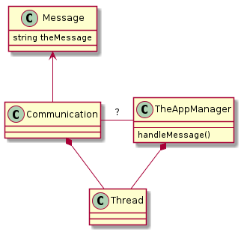
The white-board design session

Slide 5
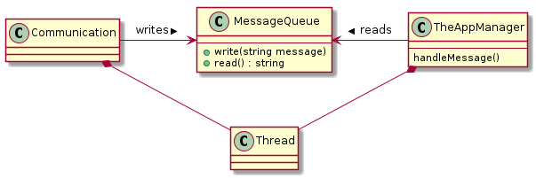
Thinking of a solution

Slide 6
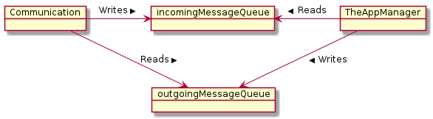
Two directions

Slide 7
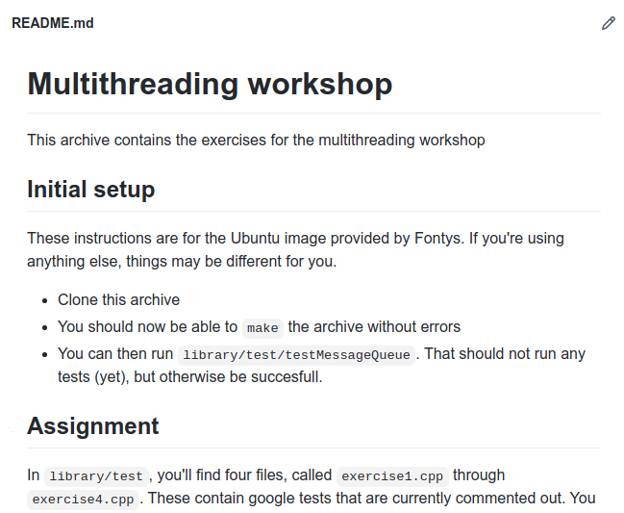
Questions?
Go to your team channel
Start coding
Record your progress
github.com/sioux-proftaak/ptt3-multithreading

Slide 8
Two kinds of blocking primitives
“Get out of my way”
  Mutices, reader/writer locks, ...
“Patiently waiting for...”
  Semaphore, condition variable, ...
Protecting
Exchanging

Slide 9
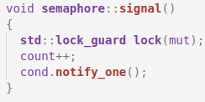
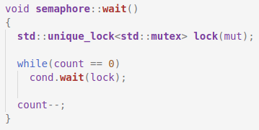
Example: Building a semaphore

Slide 10
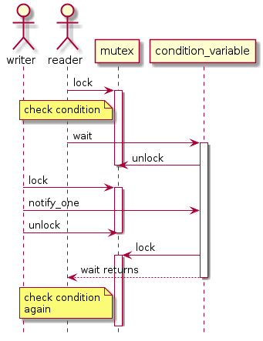
What does it do?

Slide 11
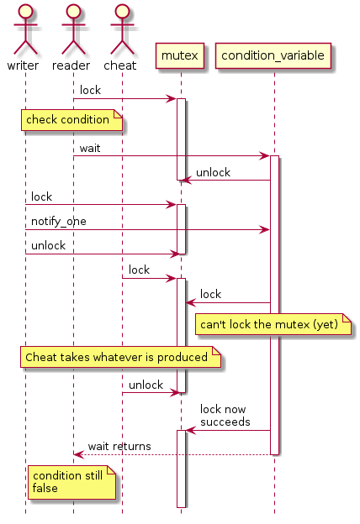
Why loop

Slide 12
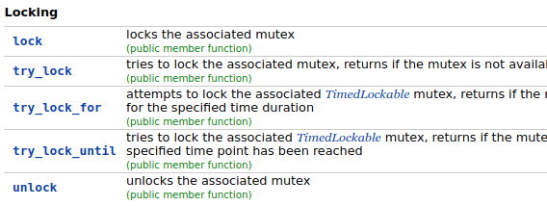
std::unique_lock members

Slide 13
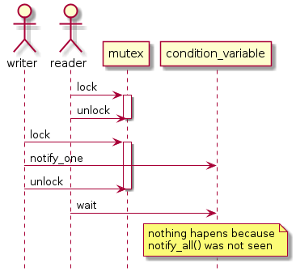
Why does the condition_variable unlock?

Slide 14
Condition variable summary
Always use a loop around the wait()
  Or use the wait() that takes a predicate
Be sure that you own the lock while doing notify_one() or notify_all()

Slide 15
Questions?
Go to your team channel
Start exercise 4
Record your progress
github.com/sioux-proftaak/ptt3-multithreading

Slide 16
Tips for working with threads
Highly recommended
Don’t use threads
Don’t share any data
Make sure any shared data is constant
Use a library containing high-level synchronization primitives
Write your own high-level synchronization primitives
If you must
Notes:
Example libraries
OpenMP
Intel’s threading building blocks
Boost (?)
Example high-level synchronization primitives
Threadpools
MessagQueue
Reader/Writer locks
Barriers
Promise/Future
...

Slide 17
Using Mutex and condition_variable is like programming in assembly:
Don’t do it if it can be avoided
Use higher level primitives instead
Unless you are masochistic

